Slide 1
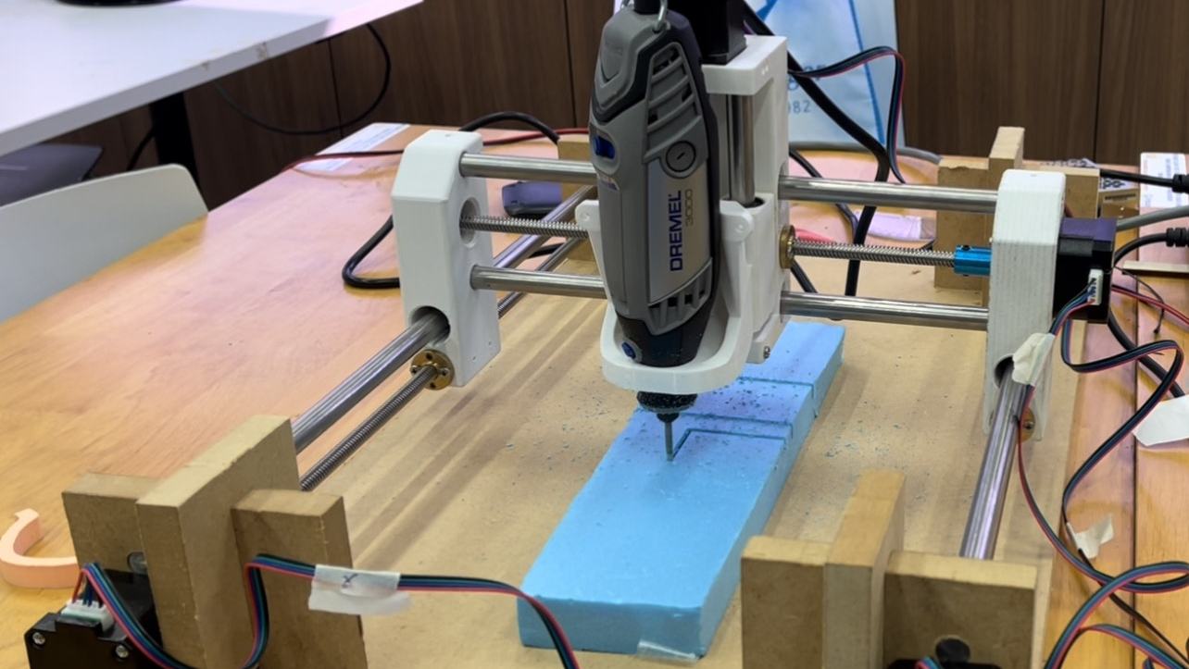
CNC MACHINE
Lee Wen Kai, Javier
DMRO/3A21
2023

